Slide 1
2010 USLARP/CERN meeting
Eric Prebys, Fermilab
Director, US LHC Accelerator Research Program (LARP)

Slide 2
Outline
Our impressions from Chamonix
Discussion
Key activities and topics
Discussion following each item
I want this meeting to be interactive, so I will keep formal presentation to a minimum. We have backup material if there are any questions.

Slide 3
Impressions from Chamonix (wrt LARP)
Energy
Doesn’t directly affect us (except for effect on overall schedule).
Collimation
A solid plan will be put in place for Phase II collimation upgrade
LARP rotatable collimators could play a part.
Crab cavities
Significant increase in enthusiasm since last year (CC09)
Base line for Phase II?
PS2/SPL
Considered unlikely at this point?
IR Upgrades
It appears there may be significant changes to upgrade plans and schedule
Obviously, this is very important to LARP.

Slide 4
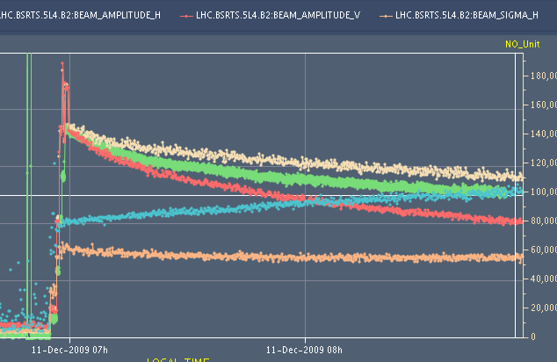
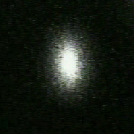
Since the last LARP/CERN meeting…
Instrumentation
Luminosity monitors fully installed and ready at IP1 and IP5
Intensity and energy too low to see so far
Analyzing potential for 3.5 TeV operation
Schottky DAQ application complete (LAFS), ready for data
Intensity too low to see so far
Issues with remote data access
AC Dipole ready for use
Awaiting permission for commissioning
Synchrotron Light Monitor
Already delivering useful information about beam
Used to measure emittance growth

Slide 5
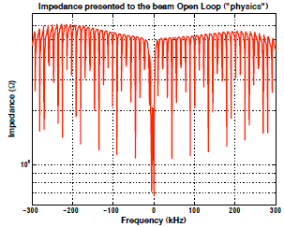
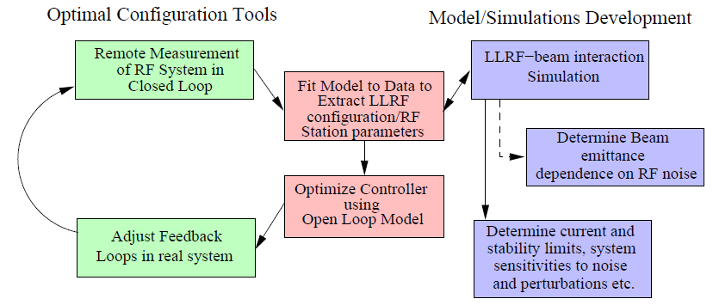
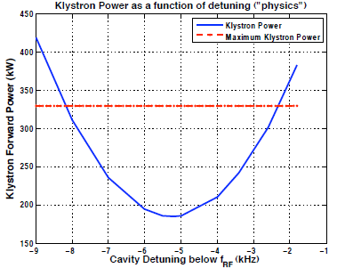
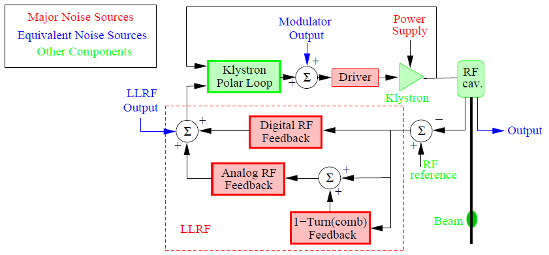
Instrumentation (cont’d)
LLRF tools developed at SLAC (J. Fox, et al) were very useful in optimizing LHC RF system

Slide 6
Discussion: Instrumentation
What is the model for remote access to data?
This has been an issue for Schottky already.
Handoff and support?
eg, who’s responsible for software?
Increased commissioning time for lumi, given new energy schedule.
What will be the impact of IR upgrade(s) (TAN rebuilt) on the luminosity monitor?
What is the future of the AC dipole?
Should LARP continue to support it?
Are there additional instrumentation topics where we could contribute?

Slide 7
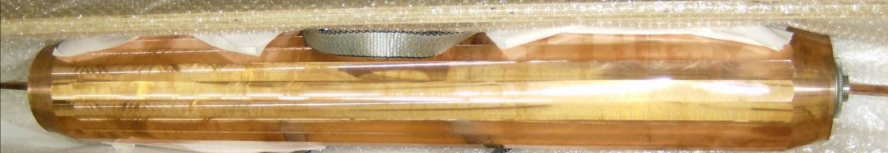
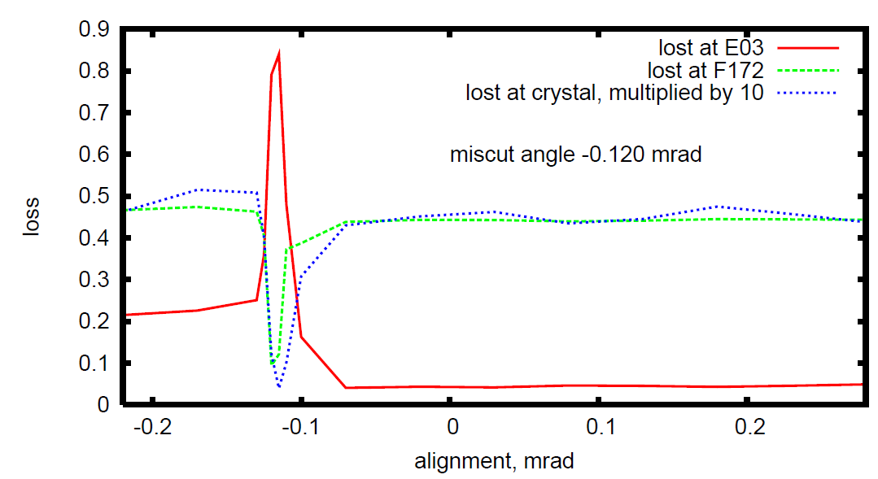
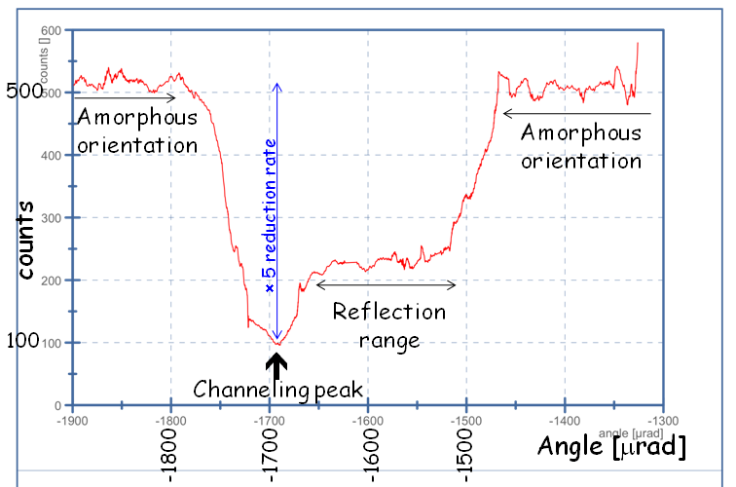
Collimation
Rotatable Collimators
Continued good coordination with CERN Phase II collimation plan
On track for prototype delivery, August 2010
Planning for SPS installation and testing after the 2010 run.
Will test in HiRadMat facility when facility is complete (mid-2011).
Crystal Collimation
Exciting demonstrations from both T980 (FNAL) and UA9 (CERN)
Test proposed in LHC
T980
UA9

Slide 8
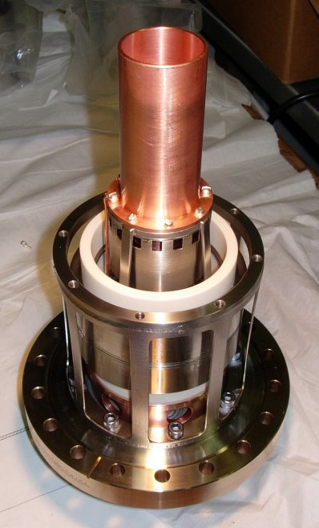
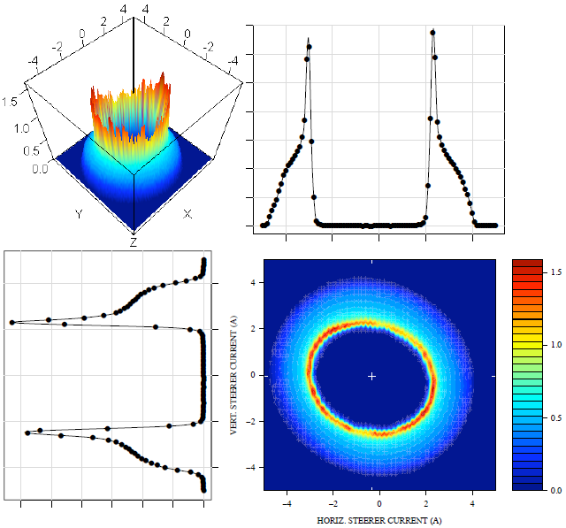
Collimation (cont’d)
New idea: hollow electron lenses as collimators/scrapers
Lots of interest from CERN
Demonstration of hollow beams at FNAL

Slide 9
Discussion: Collimation
Are LARP plans consistent with CERN expectations regarding prototyping and testing of the rotatable collimators?
Current plan is one prototype for both SPS and HiRadMat facility.
Do we need two?
If rotatable collimators are found acceptable for CERN use, what model is envisioned for construction
CERN?
US project (a la APUL)?
Are crystal collimation and/or hollow electron beam seen as possibilities for the LHC future?
Given our limited resources, how much effort should LARP commit?
Are there other ways LARP can contribute to the collimation effort?
eg, redirect accelerator physics effort from electron cloud and/or beam beam?

Slide 10
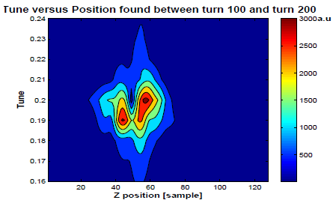
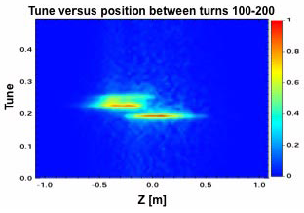
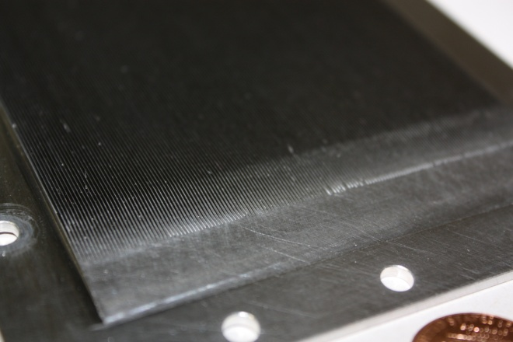
Accelerator Physics
e-cloud
E-cloud simulations have focused on developing the specifications for an RF feedback system in the SPS, based on MD periods in 2008 and 2009.
These studies have also contributed to new vaccuum chamber design
Prototype inserts to be installed in the SPS.
Data
Simulation

Slide 11
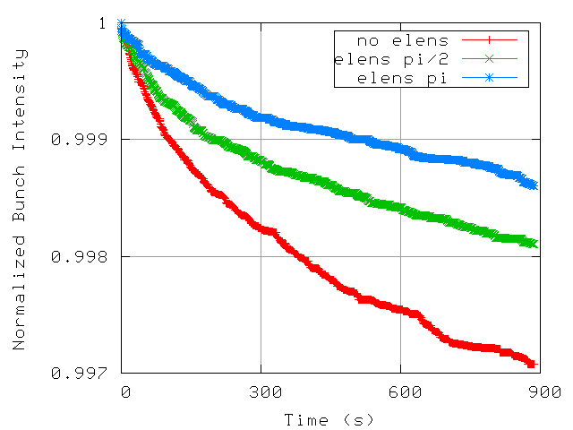
Accelerator Physics (cont’d)
Beam-beam
Electron lens
Gaussian gun installed in Tevatron
Evaluating multiple simulation tools for Tevatron, RHIC, and LHC
BNL received $4M in stimulus money to work on electron lenses for RHIC, and we’re investigating how to profit from that program.

Slide 12
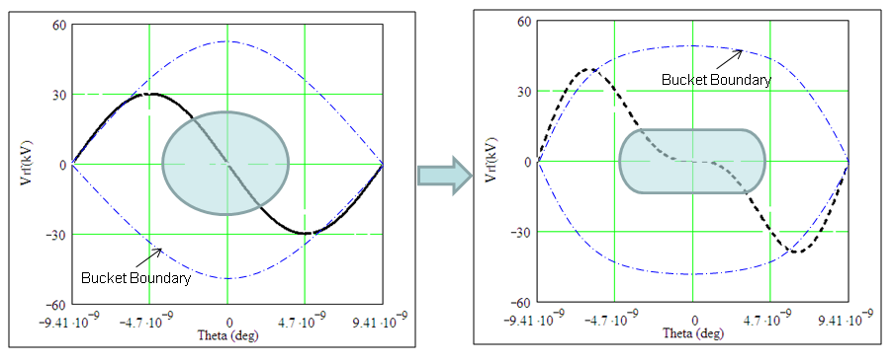
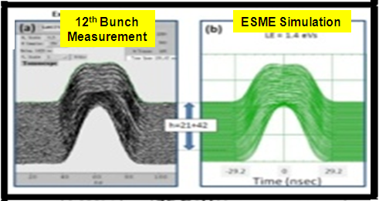
Beam-beam (cont’d)
Flat beam studies for LPA solution
C. Bhat undertook a series of studies in PS to investigate flattening bunches with higher harmonic for LPA solution
Theory:
Measurements and simulation at 26 GeV in PS
Note: Bhat starts as an LTV later this year

Slide 13
Discussion: Accelerator Physics
Accelerator physics is one of the areas where LARP can make significant contributions to the LHC
This is because much of the scientific effort comes “for free” from the labs
Is it CERN’s impression that we are using our resources as effectively as we can?
Electron cloud?
Beam beam?
Are there other areas where we can assist?
Collimation?
Crab cavity issues besides cavity design?

Slide 14
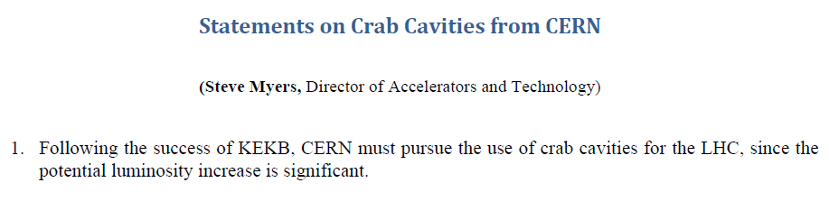
Crab Cavities
Crab cavities have now become the base line plan for Phase II luminosity and luminosity leveling.
LARP has played a major role in bringing crab cavities to this point, however the resources needed to fully manage this effort are well beyond LARP
The infrastructure requirements alone demand a central CERN role.
Discussion: What are CERN’s plans to move forward with the crab effort and how can we best contribute?

Slide 15
PS2
LARP has planned to commit significant resources to the PS2 white paper.
Agreed to write chapter on collective effects and feedback
Uli Wienands is currently here as a Long Term Visitor to coordinate the effort
In light of Chamonix, need to think about re-scoping
We don’t want to put a lot of effort into a paper if the project isn’t going to go forward.
Consider a de-scoped conceptual design to be completed this calendar year?
Given our interest in collective effects, does it make sense to make the studies generic enough that they’re also applicable to a consolidation of the PS?

Slide 16
Personnel Programs
Toohig Fellows (postdocs)
Helene Felice (LBNL)
ended Toohig Fellowship, now LBNL staff
Riccardo di Maria (BNL)
Beam beam studies
Analyzing SPS e-cloud data
Investigating crab cavities
Ryoichi Miyamoto (BNL)
AC Dipole
Luminosity monitor
Dariusz Bociam (FNAL)
Modeling heat transfer in Nb₃Sn magnets
Temperature effects on Nb₃Sn conductor

Slide 17
Personnel Programs (cont’d)
Long Term Visitors
Steve Peggs (BNL)
UA9 (Now moved on to ESS)
Jim Strait (FNAL)
Played an important role in data analysis and diagnostic development for superconducting joints following Sep. 19.
Alan Fischer (SLAC)
Significantly improved optical design of synchrotron light monitor
Elian Gianfelice-Wendt (FNAL)
Commissioning
Rama Calaga (BNL, former Toohig Fellow)
Commissioning, coordinating crab cavity effort
Uli Wienands (SLAC)
Coordinating US PS2 effort, UA9, and LHC machine studies
Chandra Bhat (FNAL)
Starting later this year to work on flat bunches for LPA.
Discussion: Are there other efforts that could benefit from an increased US presence?

Slide 18
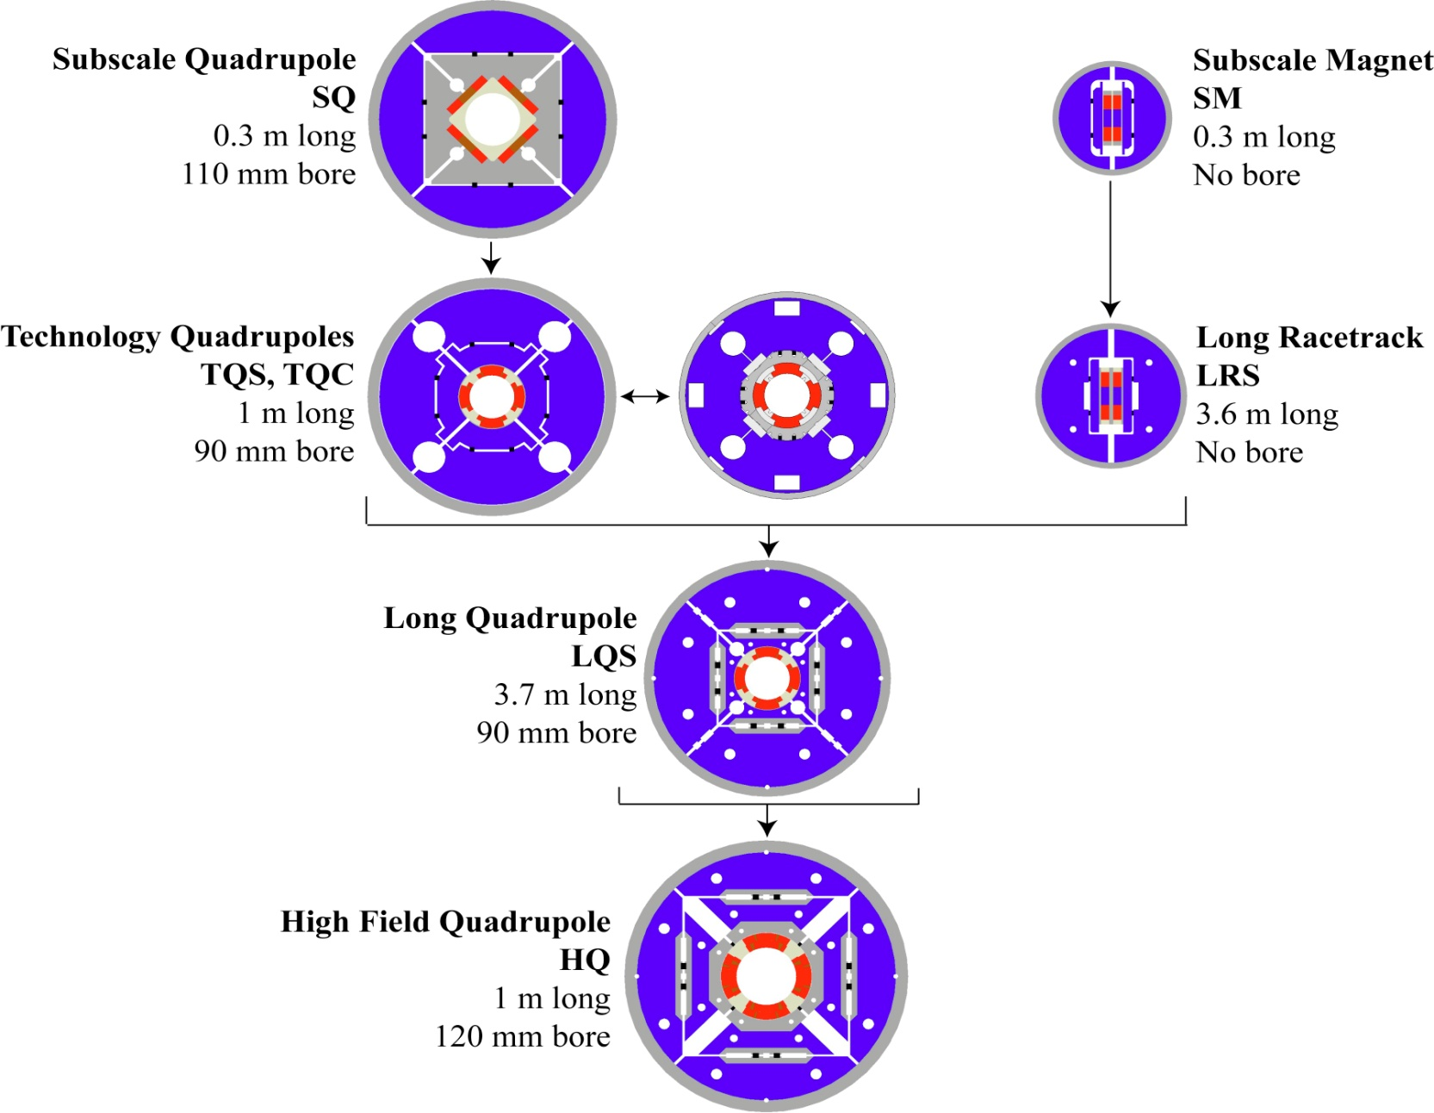
LARP Magnet Development Chart
Completed
Achieved
200 T/m
Length scale-up
High field
Accelerator features
1st test
4/2010

Slide 19
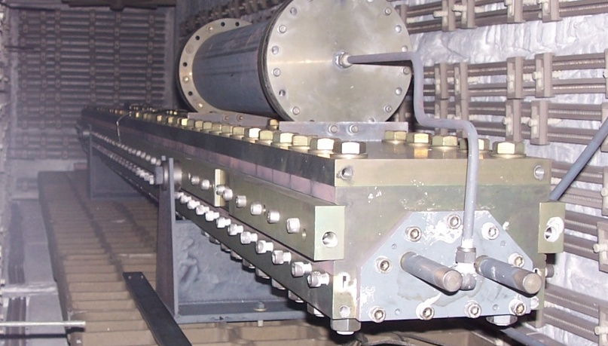
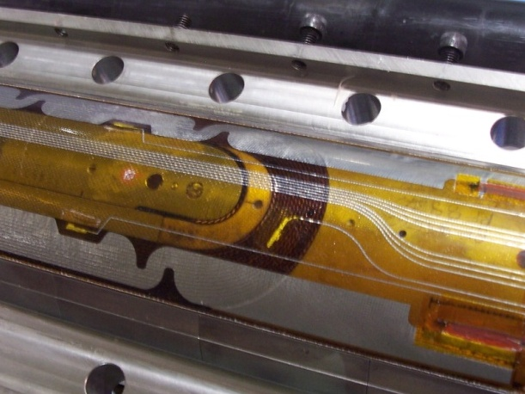
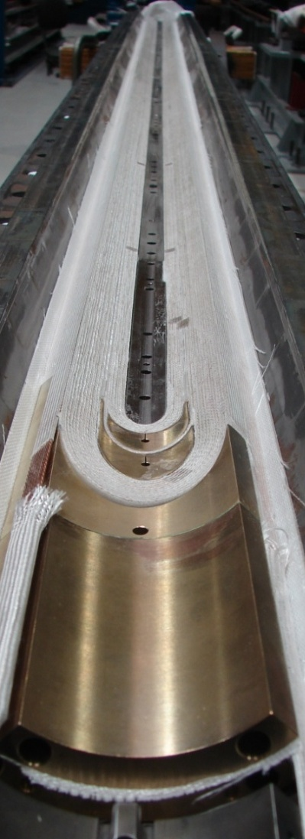
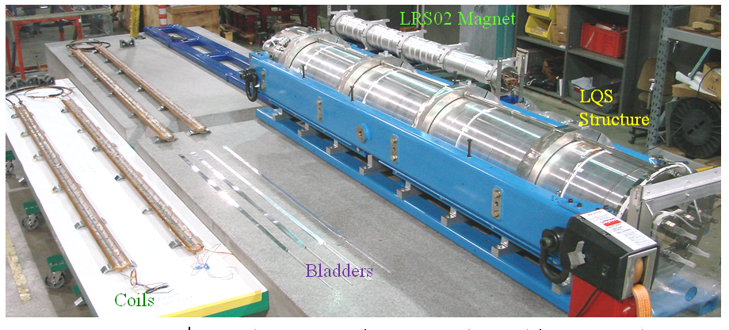
LQ (4m x 90mm) Assembly and Test
Reaction/Potting
(BNL and FNAL)
Instrumentation and
heater traces (LBNL)
Winding/curing (FNAL)

Slide 20
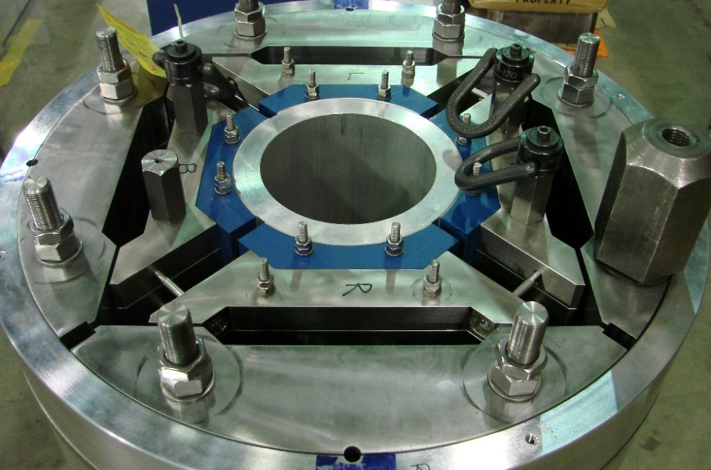
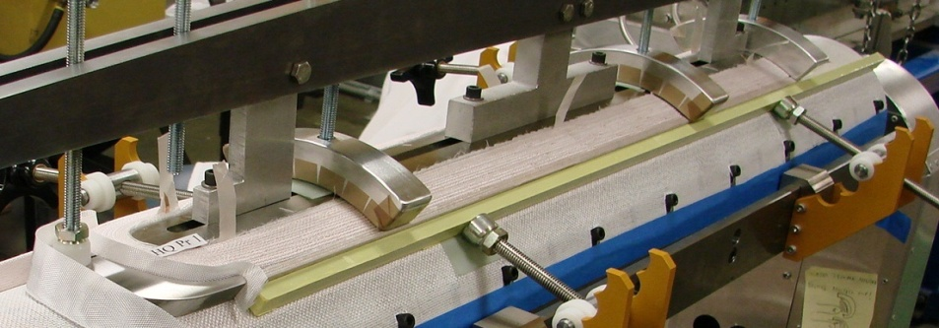
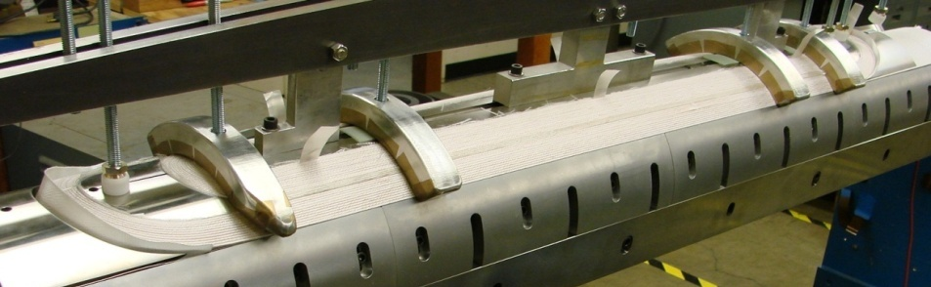
HQ (1m x 120mm) Activities
Structure assembly
Layer 2 Winding
Layer 1 Winding
Structural pre-assembly complete
Will be tested in 2010

Slide 21
Magnet Plans
2010-2012: complete technology demonstration/qualification
LQ addresses all length-related issues
HQ addresses performance limits and accelerator features
2012 +: full scale prototypes and production
Preparations (2010-2012):
Converge on design specifications
Project planning, infrastructure upgrades
Nb₃Sn design options and timelines:
120 mm aperture & <6 m length: ~2016
Larger aperture & longer length: ~2018
Discussion: How does this match with CERN’s plans and expectations?

Slide 22
Any Other Business??

Slide 23
Backup SLIDES

Slide 24
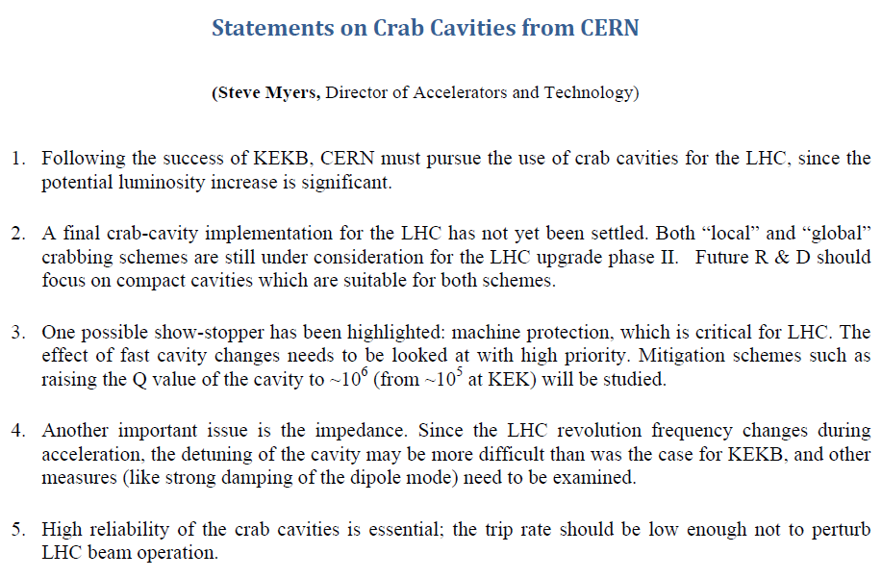
Crab Cavities
In a major shift from last year, crab cavities have gained significant priority in CERN’s overall planning

Slide 25
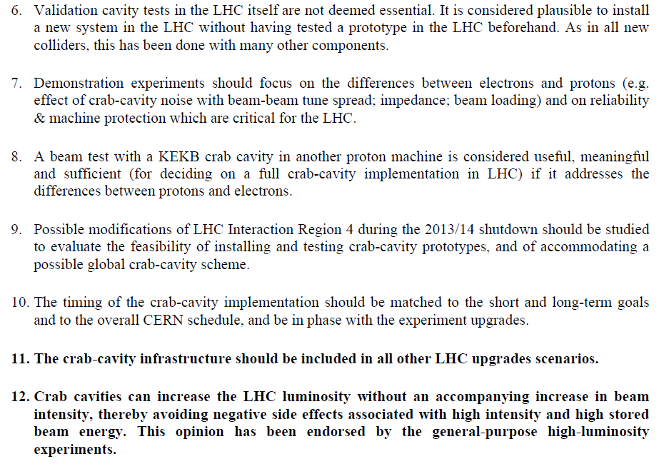
Kills Phase I Test

Slide 26
PS2
In response to requests from CERN, LARP has organized significant effort to support the PS2 white paper (nominally due in 2012)
Ultimately endorsed by review committees, the member labs and DOE
Committed to writing the “Collective Effects and Feedback” chapter:
Space-charge:
check results for validity, scan working point, effect on lattice functions (if possible). Add E-ramp.
Instabilities:
Continue (Cu-)coating investigations; impedance of components as available.
e-Cloud:
include quadrupoles in build-up model, refinement of beam-instability estimates.
Feedback:
Spec. needed to deal with res. wall growth time(?)
IPM needs re-grouping.
Uli Wienands is currently at CERN as a Long Term Visitor to coordinate effort
But…

Slide 27

Magnet Systems*
Made the important technology decision between “collared” (traditional) and “shell” pre-load design: all future LARP work will focus on shell
*see G. Sabbi, CERN BE Seminar, Jan. 12, 2010, for details

Slide 28
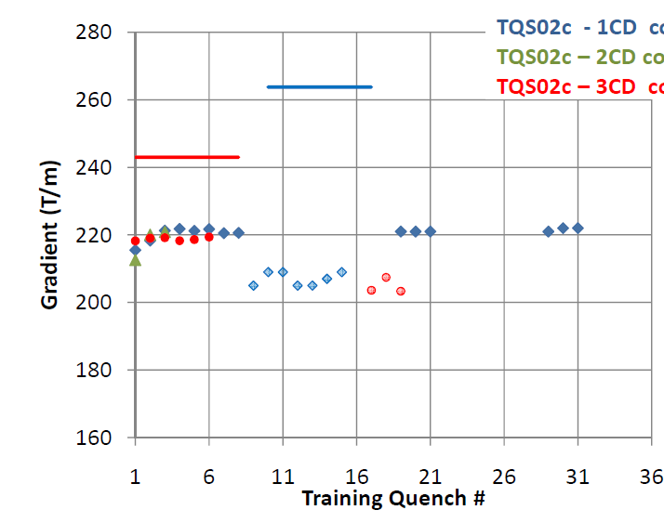
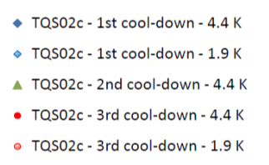
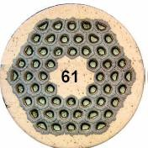
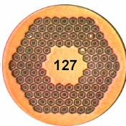
Conductor Choice
TQS02c test (CERN)
SSL 1.9K
SSL 4.4K
The 54/61 conductor which we have traditionally used showed instability problems at 1.9K
These appear to be solved with the finer filament 108/121 conductor
The 108/127 conductor will be the choice for all future magnets.
TQS03a test (CERN)
SSL 1.9K
SSL 4.4K

Slide 29
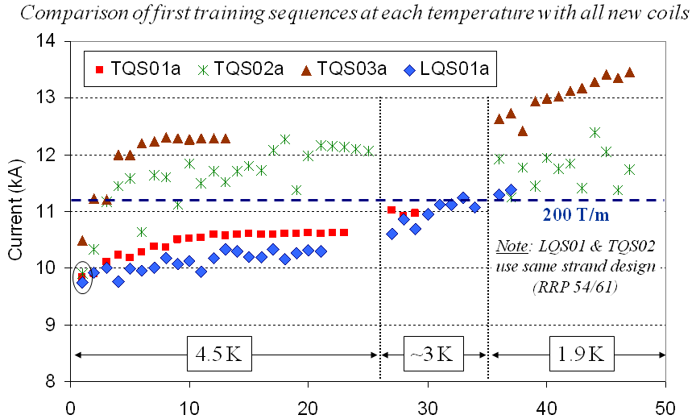
LQ Results
First long quad
The first LQ met 200 T/m design spec !!,
However, based on TQ results, we expect it to go higher
Believe this can be done by mechanically shimming the coils

Slide 30
Discussion: Magnet Program
A lot rests on the Phase I decision
If Phase I goes ahead, it will almost certainly be delayed, which would further delay Phase II
Phase I 2017?
Phase II 2022 or 2023?
If Phase I is canceled, it could move the schedule up, in terms of when the experiments are ready, however
Unlikely either the crabs or the magnets could be ready before 2020.
In any event, are LARP’s plans regarding magnets sufficient to demonstrate the Nb₃Sn as a viable technology for the Phase II upgrade?
If not, why not?

